Slide 1
CHAPTER SEVEN
POPULATION OF ETHIOPIA AND THE HORN

Slide 2
Introduction
Human population can be considered as a point of reference from which all the other elements are observed, and from which they all, derive their significance and meaning.
Many disciplines like Geography, Demography, Economics, Epidemiology, Sociology and many more study human population.
Population numbers, dynamics, densities, characteristics and qualities vary in space. These variations can be studied at different levels: district, provincial, regional, national, continental and global.

Slide 3
Population Data: Uses and Sources
Regular and reliable population data are vital for:
Effective socioeconomic development Planning &
Administration
Demographic data are crucial to administrators, businessmen, researchers, academicians and planners
Therefore, it becomes inescapable to have population information as the demography influences production, distribution, consumption, defense& administrative services at any administrative or natural unit considered.

Slide 4
Sources of Demographic Data
There are three conventional sources of obtaining population data namely census, sample survey and vital registration.
Census: defined as the total process of collecting, compiling and publishing demographic, economic and social data pertaining at a specified time (s) to all persons in a defined territory.
  Major characteristics include.
      Universality: inclusion of all persons in a given area during the count,
      Periodicity-undertaking at regular time intervals with reference to a defined point of time usually 10 years and 5years,
      Simultaneity- undertaking in a very limited time duration called the census day/night,
    Government sponsorship - costly/expensive…

Slide 5
Approaches to census: There are two procedures for collecting census data: dejure and defacto approaches
Dejure approach: it involves counting people according to their usual place of residence (where he/she lives most of the time).
This system gives a picture of the total permanent population of an area thereby making it suitable for planning and administrative purposes.
2. Defacto approach: Under this approach each individual is recorded at the place where he/she was found at the time of the census.
The Defacto enumeration may give enlarged totals to holiday resorts.

Slide 6
2. Sample Survey : taking only a portion of the population
This is a method in which a defined population/sample/ is selected with the view that information acquired would represent the entire population
3. Vital registration: recording vital events, like birth, death, marriage, divorce, adoption

Slide 7
Population Dynamics: Fertility, Mortality and Migration
The population of any particular region (country) grows/declines as a result of the combined effect of the three demographic variables: fertility, mortality and migration
According to the first ever census return of 1984, the population of Ethiopia was 42.2 million.
Rate of growth of the population in 1984 was 2.9 %.
The total population grew to 53.5 million in the second census held in 1994. The country’s population reached about 73.8 million in 2007.
Based on projected data from CSA, in Mid 2019, Ethiopia has an estimated population of 112 million

Slide 8
Ethiopia ranks 12th in the world, and the current growth rate is about 2.6%.
The largest part of the population (80%) is rural.
About 65 percent of the population is below 24 years of age.
The population is also unevenly distributed.

Slide 9
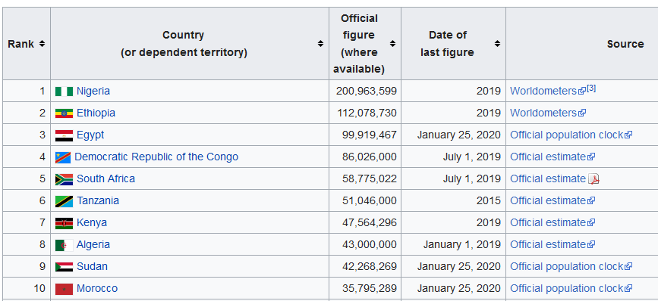
Rank-Top 10
https://en.wikipedia.org/wiki/List_of_African_countries_by_population

Slide 10
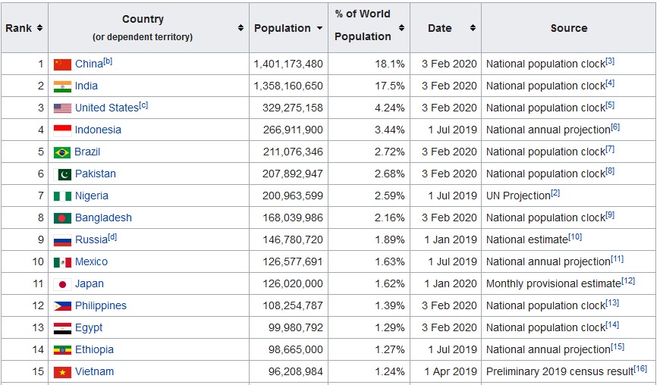
Rank-Top 15-World
https://en.wikipedia.org/wiki/List_of_African_countries_by_population

Slide 11
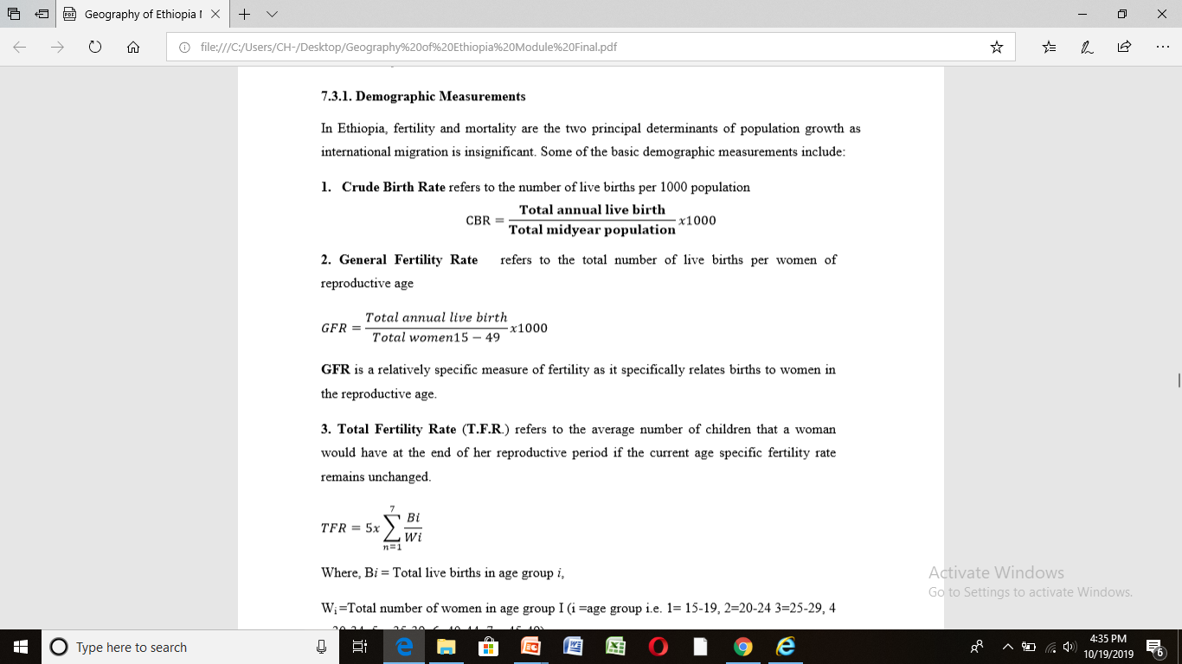
Fertility Measurements

Slide 12
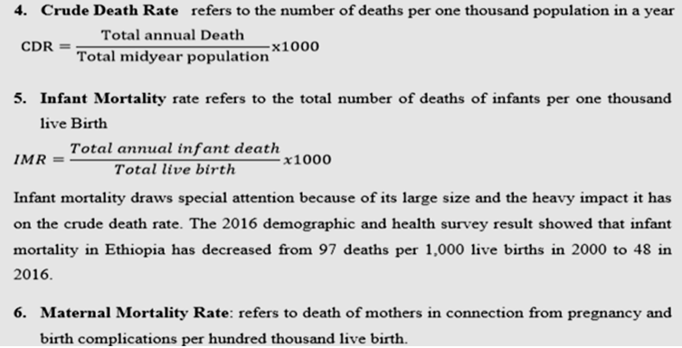
Mortality

Slide 13
7. Life Expectancy at birth: refers to the average number of years that a newly born baby is expected to live. It is used as a summary measure of the mortality experience of the whole population.
8. Natural Rate of Increase: is the difference between crude birth rate and crude death rate expressed in percentage.
RNI= (C.B.R. - C.D.R.)

Slide 14
Levels and trends in Fertility and Mortality rates in Ethiopia
Clear differences in birth and death rates are emerging between rural and urban areas of Ethiopia
High in rural and low in urban areas
Women in rural areas have an average of 5.2 children, compared to 2.3 children among women in urban areas.
Currently, women in Ethiopia have an average of 4.6 children.

Slide 15
Similarly, mortality rates are also showing a declining trend
Mortality rates also show considerable variation by regions.
Life expectancy at birth in Ethiopia increased from about 36.7 years in the 1960s to 62.6 years in 2016

Slide 16
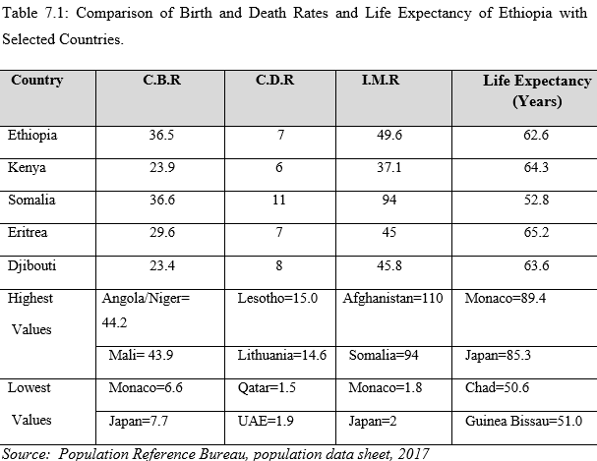

Slide 17
As opposed to declining death rates, birth rates have remained high due to:
  Little family planning practices and lack of population education;
  Lower status of women
  Early marriage, particularly of females;
  Parents consideration of children as assets, though little obliged for their education, health;
  The relatively high infant and child mortality rates, that trigger couples to have more births to compensate for the loses and
  Perhaps religious influences

Slide 18
Population growth is high in Ethiopia. Some of the consequences of this rapid population growth under conditions of slowly growing economy include:
  low per capita GNP
  increased unemployment and under-employment
  mounting social ills such as destitution, begging, theft, prostitution
  continuous inflation that erodes purchasing power of the currency
  shortage of cultivated land and food shortages
  overcrowding of infrastructural and social facilities; housing problems and increase in urban slums and squatter settlements
  Environmental problems such as deforestation, soil erosion, loss of biodiversity and pollution.

Slide 19
Migration in Ethiopia and the Horn
Migration is an old and inevitable phenomenon,
Has accelerated these days as a result of economic and technological progress

Slide 20
Implications of migration
Yields an increased level of urbanization;
It influences spatial population distribution
Migration negatively influences human fertility and mortality patterns and levels; and affects age and sex composition of the population.
It is a means of achieving economic efficiency.
It can also be a cause and consequence of inequality and unequal development
It is regarded as a cause and consequence of diversity; and a mechanism of spreading cultures
It is a necessary condition for the creation and strengthening of a sense of nationhood and national unity
It creates a creative and open society to new ideas than a homogenous group of people.

Slide 21
A. Internal Migration in Ethiopia
Ethiopia is an ancient original abode/home of human migration before the various parts of the world are occupied. In Ethiopia, both short and long migratory movements have been going on for millennia in time and space influenced by demographic, environmental, socio-economic and political factors.

Slide 22
B. International Migration
Today, Ethiopia could be considered as one of the countries that has a large number of emigrants overseas. Ethiopia’s diaspora, estimated to be about four million, is also considered one of the largest of all African countries.
Large numbers of Ethiopian migrants are found in the Middle East, USA, Canada, Europe and African countries such as Sudan, Kenya, South Africa and Botswana…

Slide 23
The causes of cross-border migration include:
Lack of employment and livelihood opportunities,
Rural underemployment and lack of resources
Unfavorable political context and insecurity, civil war and political turmoil,
Ethiopia’s location in the fragile region of the Horn of Africa and its long boundary that extends over 5,328 km which makes border management difficult
Existence of large number of local brokers
Misinformation and false promises by brokers/traffickers; success stories of pioneering migrants; family and peer pressure.
Emergence of “culture of migration‟ and migration networks.

Slide 24
International Labour Organization/ILO/ in 2016 identified the following migration source areas of Ethiopia with high and growing incidence of emigration:
    Dessie (North and South Wollo) area;
    Shashemene (Western Arsi and Bale) area;
    Jimma (Western Ethiopia) area;
    Mekelle/Tigray area;

Slide 25

Age and Sex Structure of Ethiopian Population

Slide 26

Dependency Ratio
In 2015 the total dependency ratio was 82.1; and youth dependency ratio was 75.8.

Slide 27
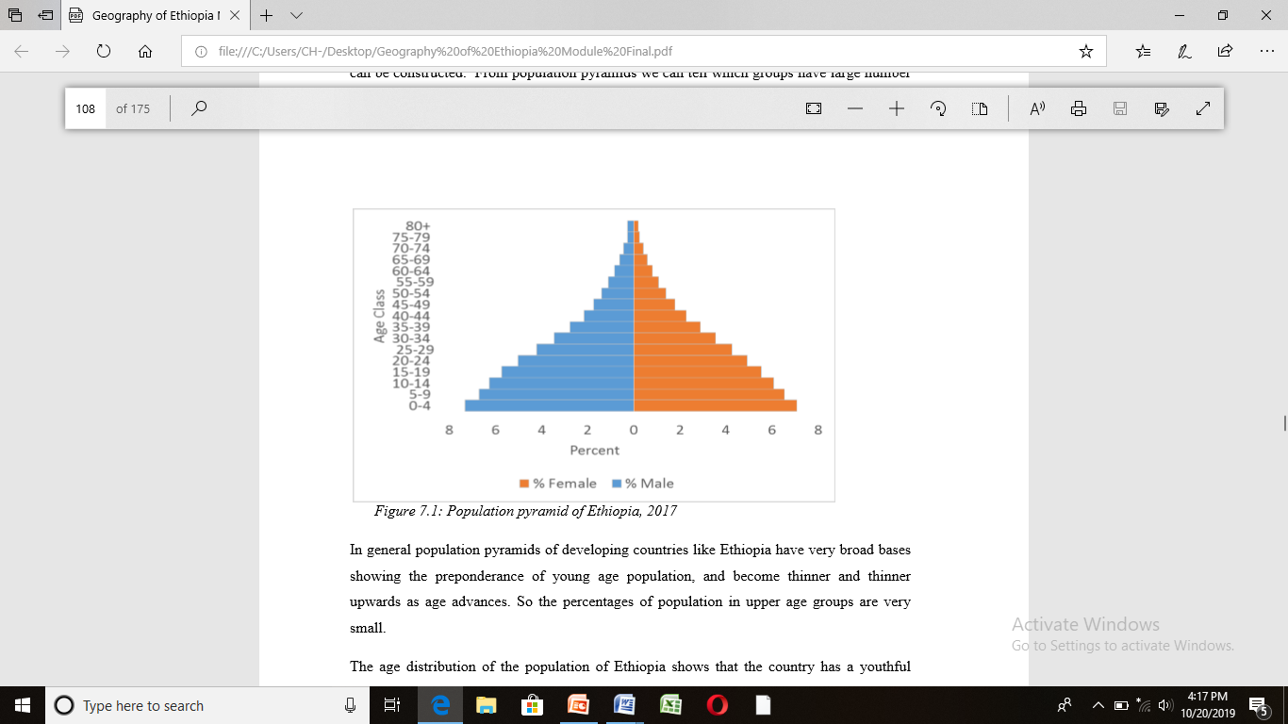
Population Pyramid

Slide 28
Implications of High Youth Dependency
Imposition of heavy burden on the working population
allocation of most of the household budget to food and other household needs with little/nothing left for saving;
diversion of limited resources on social services -building of schools and hospitals and purchase of medicines, etc.
creation of a society with booming babies that require an expansion of employment opportunities...
further promotion of high-level fertility by increased number of women entering the reproductive age (ages 15-49) annually.

Slide 29

Sex Structure
Sex structure refers to the ratio of male population to female population at different age groups. It is usually expressed as:
According to the 1984 census result, sex ratio for the population of Ethiopia was 99.4. This means that there were about 99 males for every 100 females.
The respective figures for rural, urban and Addis Ababa populations were 100.9, 86.8 and 90.2.
The 1994 census result shows that it was 101.3 for the country and 102.6, 93.3 and 94, respectively, for rural areas, urban areas and Addis Ababa.

Slide 30
Sex Ratio…
In 2015, male to female ratio for Ethiopia was 99.96 males per 100 females. Sex ratios are generally lower for urban areas, and higher for rural areas primarily due to larger female in-migration to urban areas.
Sex composition of the population also shows some variation by region. In Afar, Somali and Gambella, the number of males exceeds that of females, while in Addis Ababa the number of females is considerably higher.
Sex ratios also vary with age. At birth and young ages males tend to be greater in number, but they become increasingly less as age increases. Hence, sex ratios are high in young age groups and low in adult and old age groups.
Greater male births account for greater number of males and high sex ratio in young ages, but because mortality of male children is greater, the gap narrows down and the sex ratios decline to fall below 100 in twenties and thirties.

Slide 31
Population Distribution in Ethiopia
The distribution of population in Ethiopia is very uneven as a result of physical and human factors operating together.

Slide 32
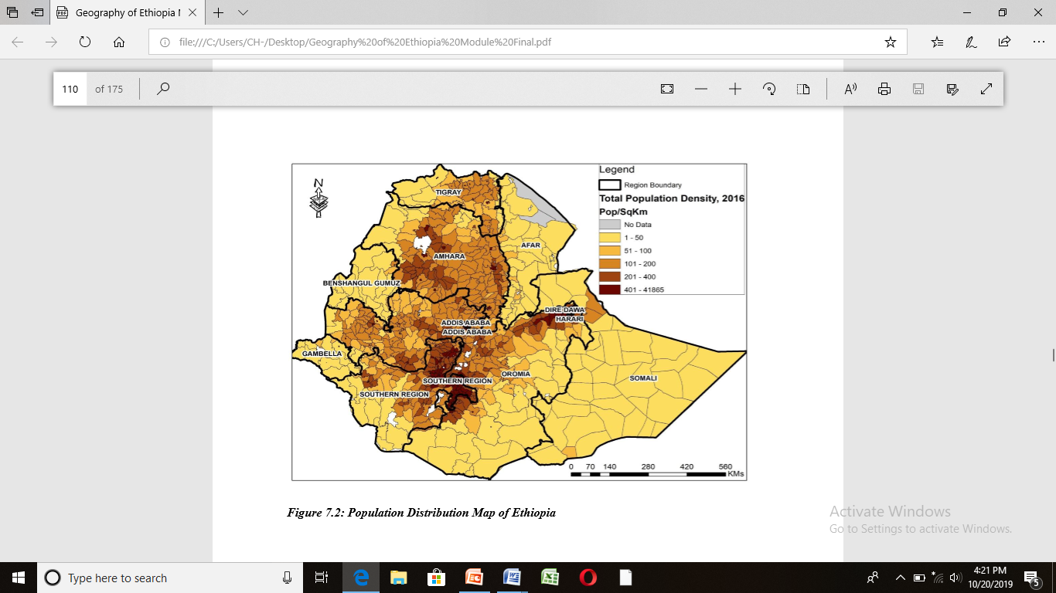

Slide 33
Measures of Population Distribution
Population density: refers to the number of people per unit area. There are several ways of expressing population density, three of which will be mentioned here.

Slide 34
Crude Density:
It is found by dividing total population to total area.
In 1990 crude density for Ethiopia was 40.74 people/km² and this has increased to 52 people /km² in 1998; and it amounted to more than 100 currently.
There is considerable variations in population density among the administrative regions of the country. Excluding the urban based administrative regions, SNNP region is the administrative area with the largest population density (173 people/km² ) followed by Amhara region. Gambella (13 people/km²), Somali, Afar and Benishangul-Gumuz are regions with low densities of population. Crude population density conceals /much of the variations within regions.

Slide 35
B. Physiological Density
Physiological density is a ratio between total population and arable part of a country.
Ethiopia's physiological density (for 1998) is 61.8 people/km².
Arable part of Ethiopia, which is used as a denominator here is 969,680 km².

Slide 36
C. Agricultural/Rural Density
This is a kind of density, which takes only agricultural population as a numerator and cultivated land as a denominator.
Rural population per square kilometer of cropland is the highest for Somali, Afar and Gambella

Slide 37
Factors Affecting Population Distribution in Ethiopia
The distribution of population in Ethiopia is very uneven. This extreme unevenness is the result of the combined effect of physical and human factors
Physical factors: soil, climate, drainage, slope
Human factors: economic activities, historical factors
In Ethiopia most of these physical factors are influenced by altitude. It is clear that from the study of climate that rainfall generally increases while temperature decrease as altitude increases. The higher the altitude the heavier the rainfall and the lower the temperature.

Slide 38
Altitude in meters | Percentage of area | Percentage of population | Population density (person/sq.km)
Above 2600 | 5.8 | 10.4 | 85.0
1800-2600 | 31.8 | 67.1 | 157.5
1400-1800 | 28.1 | 11.5 | 68.14
1000-1400 | 13.4 | 8.2 | 69.14
Less than 1000 | 21.5 | 2.8 | 29.0
Total | 100.0 | 100.0 | 6.2

Slide 39
Lowlands are characterized by scarcity of rainfall, relatively high temperature. Together with soil problems and prevalence of tropical diseases, such as malaria, the area is characterized by sparse population distribution.
However, with improvement of agricultural technology and medical services; use of the existing rivers and flat lands for irrigation the area can potentially attract huge population.
Types of economic activities strongly influence the carrying capacity of land and it in turn influences the number of people that can inhabit an area.
Ethiopia as a country of diverse environmental and cultural conditions offers ample evidence of this.

Slide 40
Socio-cultural Aspects of Ethiopian Population: Education, Health and Languages
Education
The total number of primary schools in Ethiopia was 34,867 in 2016;
Gross enrollment at primary first and second cycles (Grade 1-8) was 9,407,490.
The Gross Enrolment Rate was 108.7%.
There is wide regional variation, with Dire Dawa and Afar having the lowest GER at 70% and 66% respectively.
Gambella& A/A. have very high GERs both over 140%.
There were 3,156 secondary schools in 2016 in Ethiopia. The national gross enrolment ratio for all secondary grades was 29.04%, (A/A has the highest GER at 82.27%).

Slide 41
Health
Despite recognizable improvements, Ethiopia has still a heavy burden of diseases but a low rate of self-reported illness and low health facility coverage and utilization
Some of the root causes of the poor health status of the population are:
Lack of access to clean water
Lack of adequate nutrition
Lack of health services
The major killer diseases accounting for about ¾ of all deaths include prenatal-maternal conditions, acute respiratory infection, malaria, nutritional deficiency for children under 5 years, diarrhea, AIDS and Tuberculosis.

Slide 42
Languages Families and Languages of Ethiopia
Ethiopia is a country of about 80 languages are spoken.
According to the 2007 Population and Housing Census, Afan Oromo& Amharic were the major mother tounges in the country accounting 33.8% and 29.3% respectively.
Somaligna (6.2%), Tigrigna (5.9%), Sidamigna (4.0%), Wolaytigna (2.2%), Guragigna (2%), Afarigna (1.7%), Hadyiyagna (1.7%), and Gamogna (1.5%)
The Ethiopian languages belong to two Supper Families: Afro-Asiatic and Nilo-Saharan.
Most Ethiopian languages belong to the Afro-Asiatic Supper Family.
The Afro-Asiatic Supper Family, is divided into three families, namely: Semitic, Cushitic and Omotic.

Slide 43
Cushitic
The Cushitic languages are predominantly spoken in central, southern, eastern and northeastern parts of Ethiopia mainly in Afar, Oromia and Somali Regional States.
It has the largest number of speakers and the widest spatial coverage.
This family of languages consists of many individual languages such as Oromigna, Somaligna, Sidamigna, Afarigna, Kembatigna, Hadiyigna, Alabigna, Gedeogna, and others.

Slide 44
Semitic
The Semitic languages are spoken in northern, central and eastern parts of Ethiopia particularly in the regional states of Tigray, Amhara, Harari and northern Southern Nations, Nationalities and Peoples' Regional State.
Some of the Semitic Languages include Amarigna, Tigrigna, Guragigna, Siltigna, Aderigna, and Argobigna.
Omotic
are predominantly spoken in the south–central and south-western parts of Ethiopia mainly between the Lakes of southern Rift Valley and the Omo River. The languages are: Wolaitigna, Gamogna, Kullogna, Kefigna, and Kontigna

Slide 45
Nilo-Saharan
are spoken in the western lowlands of Ethiopia along the border with Sudan, in Gambella and Benishangul Gumuz Regional States.
These Languages are spoken by small numbers of people often less than 500,000 people.
The individual languages of Nilo-Saharan Supper Family include Kunamigna, Bejigna, Gumuzigna, Maogna, Kewamigna, Nuerigna, Annukigna, and others

Slide 46
Settlement Types and Patterns
Settlements are divided into two, namely, rural and urban
i. Rural Settlement
The vast majority of the Ethiopian population still lives in rural settlements consisting of hamlets and villages.
It can be temporary or permanent depending on whether there is frequent change in the site of the settlements.

Slide 47
Temporary / Mobile Settlements
The lowlands in most parts of the Rift Valley and peripheral areas, being generally hot and dry, are characterized by pastoral herding& mobile settlements.
The settlements are mobile because pastoralists have always been searching for new sites for water& pasture.
Permanent Settlements
Settlements are considered as permanent if there are no frequent changes in their locations. Most Ethiopian rural highland settlements where crop cultivation is practiced are permanent
It is of two types: scattered (also called diffused or dispersed), while the other one is known as grouped/ clustered or nucleated

Slide 48
Urban Settlements and Urbanization in Ethiopia
Urbanization refers to the increase in the percentage of the population living in urban centers
Shift from rural to urban
Urbanization is crucial to sustain the pace of economic development and improve the quality of life for both urban and rural populations
If the rapid urbanization is not properly managed, it is presumed to bring with it a number of development challenges such as unemployment, housing shortages and informal settlements, infrastructural and service shortages, poverty and social distress

Slide 49
The major criteria used to classify settlements as urban in Ethiopia are:
i. Minimum of 2,000 people;
ii. ²/³ of the population engaged in non-agricultural activities;
iii. Chartered municipality;
iv. The presence of social services and amenities
The number of settlements meeting these criteria in 1984 was only 322
Accounts 10.23 percent of the total population
1994 had increased to 539.
These have 12.8 percent of the country's population.
While In 2007, the number further rose to 927.
Today, the urban population is about 20% of the country's population.

Slide 50
Drivers and Opportunities for more Urbanization in Ethiopia
The establishment of Addis Ababa as a centre of expansion, and its permanency thereof.
The construction of the Ethio-Djibouti railway line
The five-year Italian occupation
The construction of roads radiating from Addis Ababa
Political decentralization
Presence of new and large commercial farms, mining areas, and agro-industries
Large infrastructure investments such as airports and highways, and dry ports that attract investment and create jobs encourage urbanisation
Opening of Universities
Tourism and attractions such as parks, resort centres, and heritage cities and sites contribute to urban expansion.

Slide 51
Distribution of Urban Centers in Ethiopia
The distribution of urban centers in Ethiopia shows considerable spatial variation.
This could be explained in terms of the varying concentration of industries; and services such as schools, health institutions, water supplies, electricity, means of transport, etc.
Based on varying concentrations of urban centers and urban populations, the Ministry of Urban Development and Construction identified the following hierarchy of urban centers:

Slide 52
i. The Addis Ababa Metropolitan cluster : includes Addis Ababa and its surrounding towns; and Adama and its surrounding towns
ii. Secondary city clusters consist of: Lake Tana Urban Cluster: Bahir Dar, Gondar Debre Tabour, Debre Markos
South Rift Valley Urban Cluster: Hawassa-Shashemene-Dila; and Hosana-Sodo-Arba Minch
Eastern Urban Cluster: Dire Dawa, Harar, Jigjiga, Mekelle Urban Cluster: Mekelle, Adigrat, Shire, Axum, Dessie- Kombolcha Urban Cluster
Jima Urban Cluster: Jima, Agaro, Mizan, Tepi, Gambella
iii. Tertiary urban clusters include: Nekemte Urban Cluster: Nekemte, Dembidolo, Gimbi, Metu, Assosa
Gode - Kebri Dar Oasis city network
Semera-Mille – Asaita oasis city network

Slide 53
Like most developing countries, Ethiopia’s urban population is concentrated in one primate city, Addis Ababa.
The population of Addis Ababa grew from 1.4 million in 1984 to 2.2 million in 1995, and to 2.7 million in 2007 representing about 29% of the urban population of the country.
Its current estimated population is over four million.

Slide 54
Growth Rate of Urban Centers
The annual average national growth rate of urban population is about 5.0 percent.
But this being an average, rate of growth of urban population varies from town to town and from time to time.
Ethiopia’s towns are characterized by wide range of growth rates that could be classified into three broad categories:

Slide 55
Growth Rate of Urban Centers
Declining Towns: towns whose populations are actually declining in absolute numbers because net out migration is greater than natural increase. This could be due to lack of employment opportunities and worsening living conditions. E.g. Axum, Goba and Maichew.
Slow Growing Towns: composed of towns that grow at the rate which is less than the rate of natural increase. E.g. Holeta, Harar and Gore have been indicated to grow slowly in the recent past.
Fast Growing Towns: growth rates of greater than the natural rate of increase. These towns pull large numbers of people from the declining or slowly growing towns and rural areas due to the opportunities they offer associated with expansion in industries, social services or a change in their administrative status as zonal or regional capitals. Once declining town could be slowly or even fast growing after sometime and vice versa.
End Page

